Slide 1


Alexa Skill Pilot
Idea 183
Vic Tandon, Patrick Holmes, Ketema Harris, Laika Kayani, Josie Ho July 2017

Slide 2
Table of Contents
I
II
III
IV
V
VI
Opportunity & Technology
Solution
Pilot Proposal
Pilot Options
Technical Plan
Resource estimates
Pilot Request and Recommendations

Slide 3
Natural Language Processing is a branch of Artificial Intelligence, which covers interactions between computers and human language.
Opportunity & Technology
Artificial Intelligence (AI)
Natural Language Processing (NLP)
Machine Learning (ML)
Deep Learning
Natural language processing (NLP) is the ability of a computer program to understand human speech as it is spoken.
There are two dimensions of NLP:
Natural language understanding – providing meaning to the natural language received by the computer program
Natural language generation – creating natural language (audible or written) from the computer’s artificial language

Slide 4

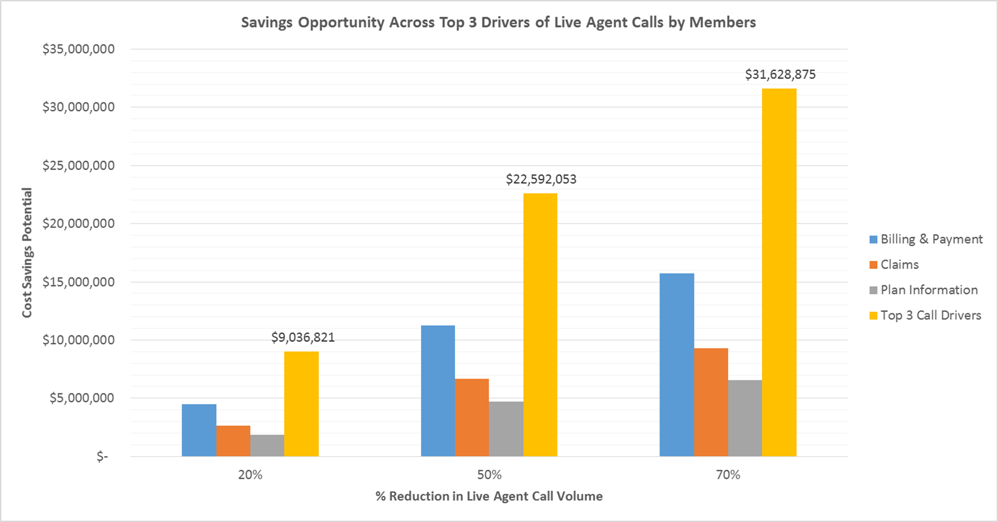
NLP drives strategic and operational opportunities for Blue Shield
Opportunity & Technology
NLP Drives ‘Trusted Advisor’ and ‘Growth’ Strategies
NLP Yields $9-31MM in Annual Admin Expense Savings
Improve customer satisfaction by building and growing digital experiences
Create more holistic member experiences
Improve price competitiveness and sustained profitable growth by lowering Administrative Expense
Strengthen Blue Shield’s Brand as an Innovator
Trusted Advisor
Growth

Slide 5
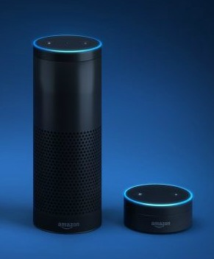
Opportunities can be captured by creating an Alexa ‘Skill’ to enhance the member experience
The Solution
3rd party developed Applications on the Alexa platform are called “Skills”
The HIT team developed a Skill for Blue Shield on Alexa
Demonstrates the application of Natural Language Processing and Machine Learning to create a new experience for members to engage with Blue Shield

Slide 6
Pilot Proposal

Slide 7
Scope
Highlight the progressive nature of the pilot phase 1 leads to phase 2 leads to phase 3 etc. Add column to describe desired learnings (success criteria) for each phase
Need clarification on Oauth from security
Jay Thakkar
Pilot Proposal
 | Non-Production | Production (Beta) | Production (Full)
Description | Enhance existing Proof of Concept and conduct focus group testing with Blue Shield employees | Build and deploy Alexa Skill to BSC Production, limiting access to BSC employees with BSC health plan for user testing. Skill not in public domain. | Build and deploy Alexa Skill to Production and make available to all BSC members with Alexa-powered devices. Skill is not in public domain. Possibility of using a beta key on a public domain skill
Users | BSC employees Alexa-powered device users Have used 3rd party Alexa Skills | BSC employees Have BSC health plan & online acct Alexa-powered device users Have used 3rd party Alexa Skills | BSC members Have BSC online acct Own Alexa-powered device at home
Use Cases | Simulate authenticated uses Unauthenticated uses | Authenticated uses Unauthenticated uses | Authenticated uses Unauthenticated uses
Timeframe | 23 weeks | 38 weeks | 30 weeks + on-going maintenance/ enhancement

Slide 8
Objectives
Pilot Proposal
Better understand NLP technology:
Assess how to incorporate technology into Blue Shield architecture
Determine what capabilities (People, Process, Technology) needed to implement and scale
Learn about user behavior:
Understand which use cases resonate with users
In what circumstances would users choose to interact with a voice assistant
Determine users’ mental models when interacting with voice assistants
Measure business impact:
Did the voice assistant decrease live agent calls?
Did the need to link with BSC account increase mobile app penetration?
Did voice assistant users increase use of other digital channels?

Slide 9
Pilot Execution will take 23 weeks
Option 1: Non-Production, Internal Pilot
Week 0
Week 4
Week 12
Week 20
Week 23
1
Scope the Pilot
2
Execute the Pilot
Iteration 1
3
Execute the Pilot
Iteration 2
4
Measure Pilot Success & Go/No Go
Define Pilot scope: refine use cases, build backlog
Define evaluation criteria, structure focus groups, recruit participants
Develop timeline and project plan
Secure sponsor and funding
Define BSC project team
Align on governance approach
Pilot readiness: training, marketing, engagement strategy, communication
Plan Sprint 1 - development & QA
Execute on Sprint (design, develop, test, deploy)
Run internal focus groups with BSC employees
Assess results of focus groups
Update backlog (e.g. use cases) and re-groom Stories
Plan Sprint 2 - development & QA
Execute on Sprint (design, develop, test, deploy)
Run internal focus groups with BSC employees
Assess results of focus groups
Update backlog (e.g. use cases) and re-groom Stories
Evaluate results of Focus Groups
Determine viable use cases for Production application
Refine EA analyses
Refine IT estimates
Plan Marketing/ Communications

Slide 10
Pilot Execution will take 38 weeks
Option 2: Production(better terms for skill publication) Private Beta Pilot
Week 0
Week 6
Week 18
Week 26
Week 38
1
Scope the Pilot
2
Execute the Pilot
3
Go-Live with Alexa Skill
4
Measure Pilot Success
Define Pilot scope: refine use cases, build backlog
EA Environmental Analysis
Implementation Solution Architecture
IT Security Review
Define evaluation criteria, structure focus groups, recruit participants
Develop timeline and project plan, including IT Estimates
Define BSC project team
Secure sponsor and funding
Align on governance approach
Pilot readiness: training, marketing, engagement strategy, communication
Plan Sprints - development & QA
Execute on Sprints (design, develop, test, deploy)
Recruit, enroll, train Beta users
Setup evaluation tool(s)
Go/No-go decision
Deploy Blue Shield “Skill” to Amazon’s Alexa Skills store
Support Beta user installation of Skill
Post go-live monitoring
Collect user feedback
Triage reported issues and deploy Bug fixes
Track metrics on daily, weekly, monthly basis; report on monthly basis
Assess and implement enhancements as needed
Evaluate expansion Beta pilot to wider user base

Slide 11
Product Rollout will take 30 weeks, followed by traditional product lifecycle processes
Option 3: Production Full Rollout
Week 0
Week 6
Week 18
Week 30
On-going
1
Scope the Production App
2
Develop Alexa Skill
3
Go-Live with Alexa Skill
4
On-going Monitoring and Enhancement
Define Pilot scope: refine use cases, build backlog
Define evaluation criteria
Develop timeline and project plan
Secure sponsor and funding
Define BSC project team
Develop post go-live communication plan
Develop operating plan
Align on governance approach
Pilot readiness: training, marketing, engagement strategy, communication
Plan Sprints - development & QA
Execute on Sprints (design, develop, test, deploy)
Enable infrastructure to support Alexa skill
Conduct UAT
Setup evaluation tool(s)
Train BSC employees on operating plan
Go/No-go decision
Deploy Blue Shield “Skill” to Amazon’s Alexa Skills store
Execute communication plan
User engagement and monitoring
Post go-live monitoring
Collect user feedback
Triage reported issues and deploy Bug fixes
Track metrics on daily, weekly, monthly basis; report on monthly basis
Assess and implement enhancements as needed following Agile product lifecycle processes

Slide 12
Use cases
Unauthenticated
Search for provider
Authenticated (pare down to ones for pilot stages 2,3)
Get an ID card Physical card request
Digital card request
ID card information
Medication reminders
Find a Provider
Changing PCP + Get an ID card
Benefits available to me – i.e. what services are covered?
Verbal search for benefits
Plan Information
How far am I in my deductible
What’s HSA balance
What’re copayment maximums
Claims Inquiries
Claims Status
EOB Inquiry
Scheduling Appointments
Medication refills
Medication reminder + Refill?

Slide 13
Overview
The Alexa skill will enable anyone with an Alexa-enabled device to interact with BSC verbally. For example:
NON-PHI | PHI
Find an Urgent Care center | Get my group number, subscriber ID
Get the BSC phone number | Get my HSA balance
Get the nurse help line number | Get the status of my claims
Define some common health insurance terms | Get the status of my deductible
 | Order a new ID card or send me the link to get the image on the web portal

Slide 14
Technical Plan

Slide 15
Alexa Pilot Technical Plan
Rev 8
Patrick Holmes

Slide 16
Objectives
Identify the capabilities and technical tasks required to move the Alexa PoC into pilot
Ensure the proposed design aligns with architectural standards
Provide a ballpark size – time, people, cost
Identify any technology and skill gaps
Not intended to conflict with BSC’s defined project lifecycle process
Provide input into the EA environmental analysis around NLP.
Determine if user base will make use of voice as alternate interaction channel.
Note: IT HIT and IT Architecture are working on a plan for Natural Language Processing (NLP) in general. This would include support for Alexa, Google Home, Microsoft Cortana, etc. It also includes an approach to Chatbots (text and messaging interfaces with an AI back-end). There are already projects in the pipeline for chat interfaces.
In order to limit the scope of the project, this document focuses only on the objectives above for the Alexa skill.

Slide 17
Risks and Mitigations
Risk | Mitigation
Alexa service infrastructure must be HIPAA compliant in order to pass PHI through it | Get written assurance from Amazon that Alexa environment is HIPAA-compliant, or get signed BAA Do not speak PHI. Send URLs to the website to the Alexa card Do not implement any features which accept or provide PHI
Meeting security requirements while enabling ease-of-use | Have user speak a PIN before accessing PHI Ensure user can easily un-link their BSC account
The interaction model is rigid | Extensive help Alexa AI will improve over time
Users may be unwilling to link their BSC accounts | Make linking as easy as possible Ensure user knows they can unlink at any time Make un-linking as easy as possible
Web service calls have a deadline of 10 seconds. Some calls may not meet the deadline | Apply standard performance improvement measures

Slide 18
Questions for Amazon
For Alexa services which would communicate PHI (but make no use of any AWS products), does Amazon see itself being a Business Associate? A transmission service?
Will Amazon sign a Business Associate Agreement? If not now, when?
Is the Amazon Alexa environment HIPAA compliant? (§164.308(a)(1))? If not now, when?
Is there a way to pilot / beta test a skill (without making it available to millions)?
Our current plan is to only link accounts where the member id is in a list of pilot participants
Are we trying to do too many features in a single skill?
Many Alexa skills only do one or two features.
Given what we have so far, is there any reason why Amazon would not publish the skill?
Assume we complete all of their checklists

Slide 19


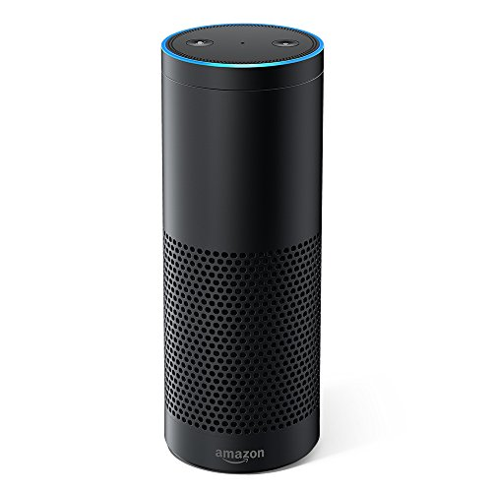



Proposed Pilot Flow *
4. The token is authenticated, and the BSC Alexa web service calls other web services to get the member’s HSA info. It replies to the service request with instructions for Alexa to read back the HSA balance.
3. Alexa recognizes “Blue Shield of California” as a skill name and looks up the service endpoint. It converts the rest of the audio to an “intent”. It sends the intent and the user’s access token to the service endpoint.
1. The member says “Alexa, ask Blue Shield of California for the balance of my HSA?”. Alexa wakes up.
2. Alexa sends the captured audio to the Alexa Service
{
intent: “GetHSABalance”,
token: “f72692d3-9a52”
}
BSC Data Center
AIP
2
Auth Service
1
3
4
BSC Alexa Web Service
4
Eligibility
service
HTTPS POST
6
5
{
ask: “The balance of…
what next?”
}
Claims
service
{
ask: “The balance of…”
what next?”
}
Other
services
Other
services
Exchange
Other
services
6. The Alexa-enabled device says “The balance of your HSA is … What next?” Because the response is “ask”, Alexa will listen for the answer (the next request).
5. The Alexa Service forwards the response to the Alex-enabled device. Because the response is “ask”, the Alexa service notes that the user is still interacting with the BSC skill.
For sending SMS messages
7. The user says “What’s the status of my deductible?”
8. Repeat steps 2-6. Because the BSC skill is still “active”, the Alexa service routes the call to the same endpoint.
After the customer has added the Blue Shield of California skill and linked it to their account.

Slide 20
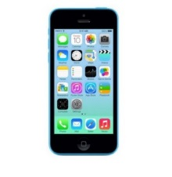
Account Linking
Linking associates the user’s Alexa-enabled device with their BSC account, and grants the Alexa skill limited access to their data.
2. The skill metadata indicates it requires linking to an account. The Alexa service instructs the app to open a web browser to a URI, which is served by BSC and provides a login screen.
1. User opens Alexa App on mobile device, searches for Blue Shield of California, and adds the “Skill”.
OAuth 2.0 Authorization code flow
BSC Data Center
2
BSC Alexa Web Service
Auth Service
Auth
1
5
4
4
3
4. The BSC web site authenticates the user and redirects the browser to the Alexa service with an authorization code.
3. The user enters their credentials and agrees to let the skill have limited access to their BSC account (until the user revokes access).
5. The Alexa service exchanges the authorization code for an authorization token and stores it on behalf of the user. All subsequent calls from that Alexa will include the token (until revoked by the user).

Slide 21
Capability Matrix
 | Capability/tech | Used in POC | Recommendation for Pilot
1 | NLP / Voice synthesis | Amazon Alexa | Amazon Alexa
2 | BSC Alexa Web Service - platform | AWS Lambda, Serverless | BSC AIP (Application Integration Platform)
3 | BSC Alexa Web Service - language | TypeScript | Java
4 | SDK | Alexa skills kit for Node.js | Alexa skills kit for Java
5 | BSC Web Services | Web services which read mock member data from AWS DynamoDB Google Maps APIs Some mock values stored in configuration files or hard-coded | Use existing AIP services whenever possible. (The call from the Alexa service has a non-configurable 10-second timeout. If we cannot consistently meet this timeout, we may need to create new web services which are more efficient.)
6 | Member account linking / authentication | None | OAuth 2.0 (Alexa supports explicit grant and authorization code grant). Recommend code grant, which prevents the authorization token from being sent to the phone. See here.
7 | Send SMS messages | Twilio | Twilio (selection of mobile messaging vendor as part of Customer Communication Management project is on hold). Messages will not contain PHI.

Slide 22
Capability Matrix
 | Capability/tech | Used in POC | Recommendation for Pilot
8 | Send eMail | AWS Simple Email Service | Integrate with existing BSC outgoing mail server. Messages will not contain PHI.
9 | Source control / Build / Deploy / Test | Git, Serverless framework from CLI | BSC SCRM and QA automation toolset
10 | User PIN | Stored with mock member date | Store in member preference center. May require portal changes (or could be captured during linking).
11 | Member preferences (e.g. do you prefer Text or Email?) | none | Store in member preference center

Slide 23
Remaining Tasks
Determine features for minimum viable product release
Design and document the interaction model for each
Intents, slots, utterances, states, state transitions
Ask IVR team for help with this, as they have vast experience
Complete development (next slide)
Ensure all Alexa publishing tasks have been completed
Set up vendor accounts and billing set up
Alexa, Twilio, etc. (twilio may not be the standard should explore alternatives)
Will review EA short list
dev, test and prod
Complete IT Design engineering
Security architecture, design, risk analysis and reviews
Business, Privacy, Legal reviews
Customer service model
For members calling for help with setting up / using Alexa
End-to-end validation
Submit to Amazon for review
Deploy pilot

Slide 24
Remaining Development tasks
Prepare test environment – access to all required web services and identity providers in the TEST environment
Rewrite code to run as a web service (rather than Lambda function) and to be hosted in AIP
Validate requests are from Alexa service only (and not replayed) – this is built into the Alexa Java SDK
Verify the request signature, Check the time stamp
Interface to new / existing BSC web services
Implement / integrate application linking with our Identity Provider / Authorization Infrastructure
Modify email interface
To use BSC mail infrastructure
To include mail header/footer changes
Unsubscribe ?
Modify BSC web site to collect and store PIN (or do it while linking. How could it be updated?)
Modify app to persist some user choices
If necessary
Integrate with DevOps tools and processes

Slide 25
Telephony
SMS
Determine responsibility / process for opt-in/opt-out of receiving SMS messages
Get a BSC Twilio account and set up a funding / payment process
Provision a phone number to be used as the sending phone number
or acquire a short code (takes 8-12 weeks)
Determine whether we will be sending to international numbers (link)
Does system need to receive and process SMS messages (such as STOP)?

Slide 26
Design Engineering Tasks
We will be using existing web container, so may not require servers, VMs, host name, DNS, digital certs, etc.
?

Slide 27
Resource Estimates

Slide 28
Resource Estimates
Project Estimate
Projected Phase End Date | Plan | Design | Construct | Accept | Close | Totals
Internal Staff Resources | $24,959.36 | $24,564.40 | $34,424.40 | $10,627.60 | $4,563.20 | $99,138.96
External Staff Resources | $3,974.40 | $11,993.60 | $19,443.20 | $5,555.20 | $2,556.80 | $43,523.20
Offshore Resources | $0.00 | $0.00 | $0.00 | $0.00 | $0.00 | $0.00
Travel | $0.00 | $0.00 | $0.00 | $0.00 | $0.00 | $0.00
Non-Labor | $0.00 | $0.00 | $0.00 | $0.00 | $0.00 | $0.00
Project Maintenance¹ (Remainder of Year) |  |  |  |  |  | $12,000.00
Total | $28,933.76 | $36,558.00 | $53,867.60 | $16,182.80 | $7,120.00 | $154,662.16
 | Plan | Design | Construct | Accept | Close | Totals
Capitalized Costs | $0.00 | $0.00 | $53,867.60 | $16,182.80 | $7,120.00 | $77,170.40
Expensed Costs | $28,933.76 | $36,558.00 | $0.00 | $0.00 | $0.00 | $65,491.76
Project Maintenance (Remainder of Year) |  |  |  |  |  | $12,000.00
Alexa Pilot - project estimate to determine the feasibility of developing and running a NLP, ChatBot using Amazon Alexa service.
Financial data above - summarized from ROM prepared by IT Product Engineering. Full IT / ROM estimate attached for reference
¹Total cost of project maintenance for one year after deployment

Slide 29
Pilot Request and Recommendations

Slide 30
Phased approach to build and deploy Alexa skill for production
Request and Recommendations
Phase I – Alexa Pilot utilizing unauthenticated use cases
Scope: Create a working Alexa skill in Java, running on our AIP platform and in our data center
Resources: IT Applications
Timeline: Mid Sep – end of Oct
Cost: $143K
Risks:
ROM Estimate provided by IT is for limited functionality of a NLP implementation, literally “Hello World” only. Implementation of the NLP features, and tying them into the existing web services is not included.
Unauthenticated use cases may provide a less than optimal user experience, which may turn user away from the experience as not worth while, too clunky, not worth the hassle.
Phase II – Partner with CE to identify business sponsor to create authenticated use cases
Scope: Create a fully functioning Alexa experience running on our AIP platform and in our data center
Resources: IT Applications
Timeline: Nov. - TBD
Cost: $TBD
Risks:
Ability to identify the appropriate business sponsor to operationalize the effort
Security, Privacy and PHI remain as high risk items that will need to be addressed.

Slide 31
Phased approach to build and deploy Alexa skill for production - schedule
Request and Recommendations
Milestone 1
8/30/17
Milestone 2
10/30/17
Aug Sep Oct Nov Dec
Innovation Council
8/21 – 9/12
Implementation Solution Architecture
Phase I
9/15 – 10/30
Alexa Development
9/22 – 10/?
Identify Business Owner
Phase 2
11/3 – 12/?
Complete Development
11/3 – 12/?
Create Use Cases

Slide 32
Thank you.

Slide 33
Appendix

Slide 34
Major Project Risks
Although much of the implementation will be hosted within BSC, the data will flow through the Amazon Alexa environment. If we cannot ensure HIPAA compliance, we will not be able to provide any PHI, limiting the value of the skill.
We could send URLs to the web site
Security and privacy are critical. The project must find a way to meet all security and privacy requirements and create a valuable experience for users. This MAY not be possible.
Example: if user is required to provide their subscriber ID and password (or even just their password) each time they use Alexa, it becomes infeasible. We have added a 4-digit PIN, but that may not be sufficient.
The interaction model with Alexa does not currently allow for “free form” discussion. It expects the user to make requests using certain phrases. This may become frustrating to users and they may stop using it.
Some skill feature will require the user to “link” it to their BSC user account, which will require them to enter their web user id and password on their phone (one time). They may be unwilling to put in the effort, or may have security concerns.

